Slide 1
PART VII
Security

Slide 2
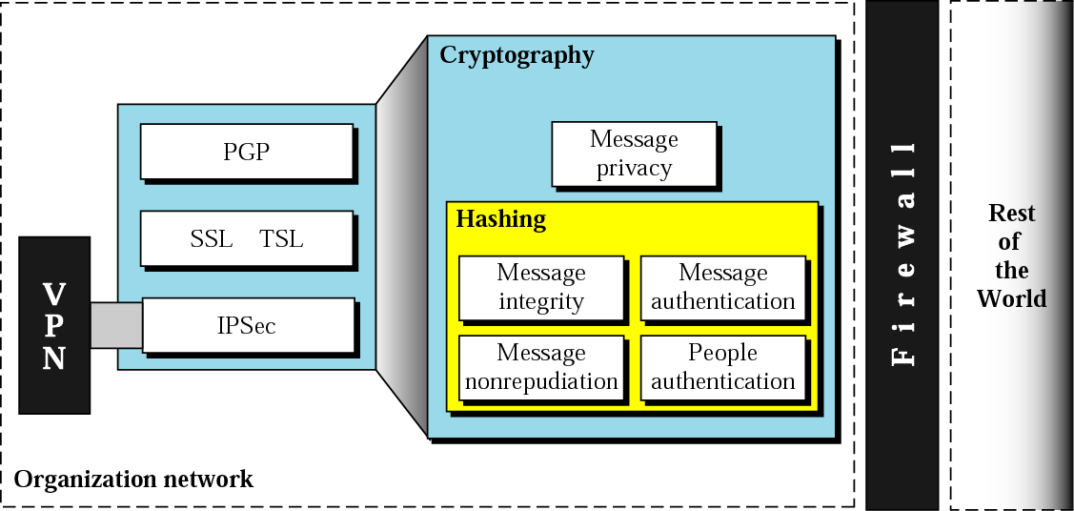
Security Topics

Slide 3
Chapter 29
Cryptography

Slide 4
29.1 Introduction
Introduction
to
Cryptography

Slide 5
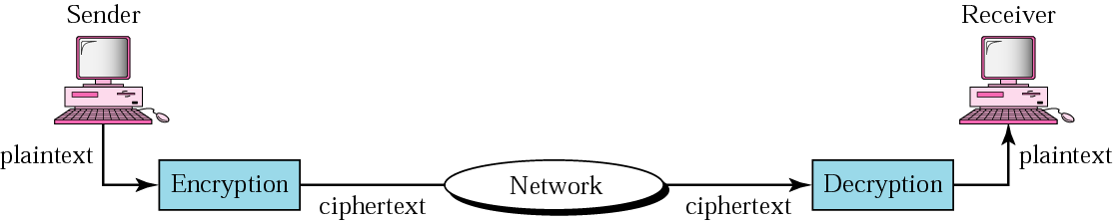
Figure 29.1 Cryptography components

Slide 6
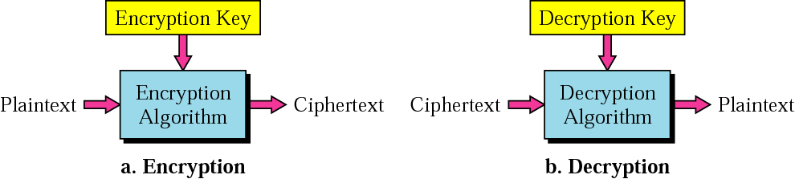
Figure 29.2 Encryption and decryption

Slide 7

Note:
In cryptography,
the encryption/decryption algorithms are public; the keys are secret.

Slide 8
29.2 Symmetric-Key Cryptography
Traditional Cipher
Block Cipher
Operation Modes

Slide 9
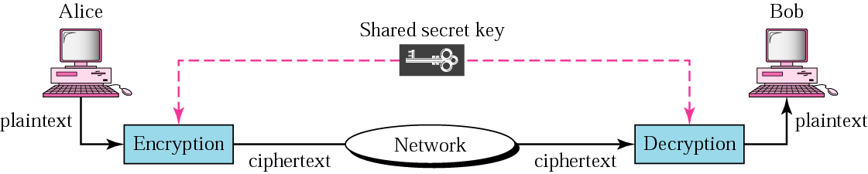
Figure 29.3 Symmetric-key cryptography

Slide 10
Note:
In symmetric-key cryptography, the same key is used by the sender (for encryption) and the receiver (for decryption). The key is shared.

Slide 11
Note:
In symmetric-key cryptography, the same key is used in both directions.

Slide 12
Note:
Symmetric-key cryptography is often used for long messages.

Slide 13
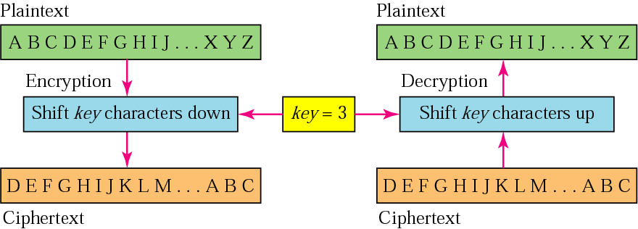
Figure 29.4 Caesar cipher

Slide 14
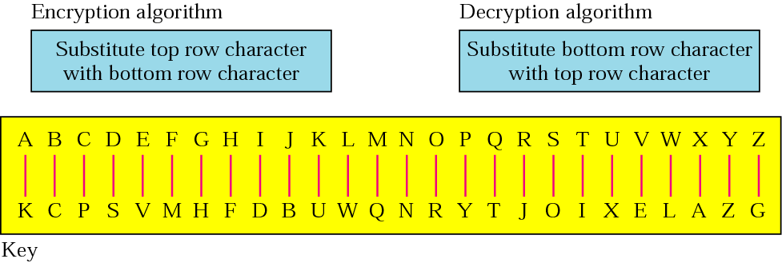
Figure 29.5 Example of monoalphabetic substitution

Slide 15
Note:
In monoalphabetic substitution, the relationship between a character in the plaintext to the character in the ciphertext is always one-to-one.

Slide 16
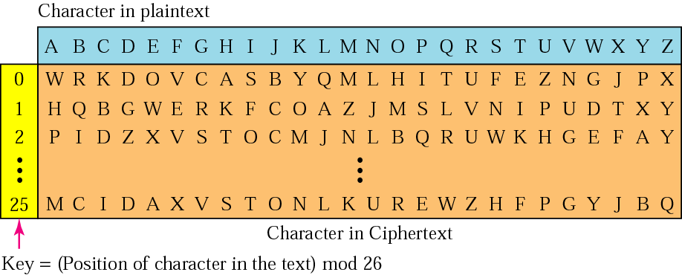
Figure 29.6 Vigenere cipher

Slide 17
Note:
In polyalphabetic substitution, the relationship between a character in the plaintext and a character in the ciphertext is one-to-many.

Slide 18
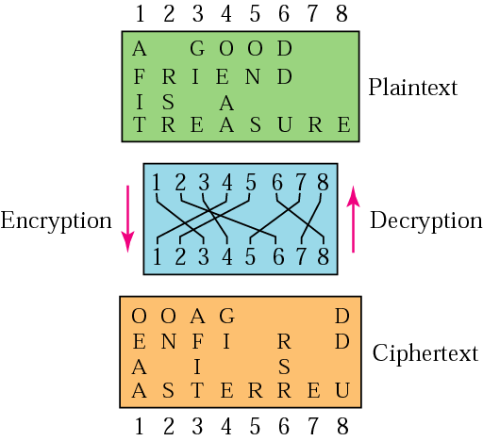
Figure 29.7 Transpositional cipher

Slide 19
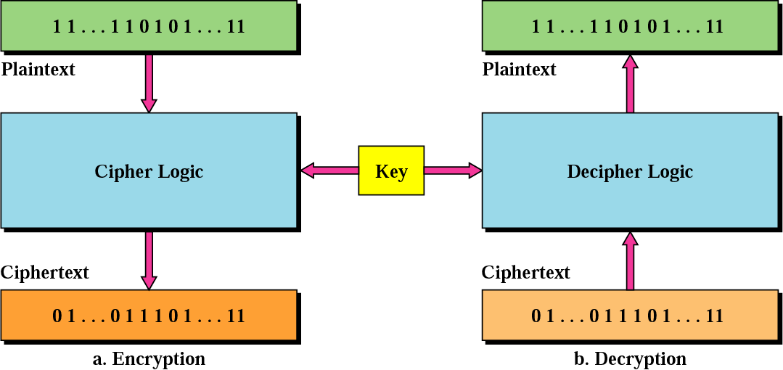
Figure 29.8 Block cipher

Slide 20
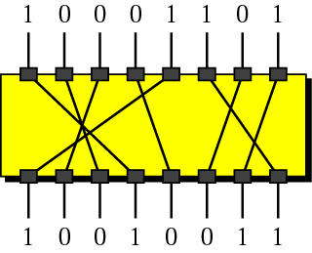
Figure 29.9 P-box

Slide 21
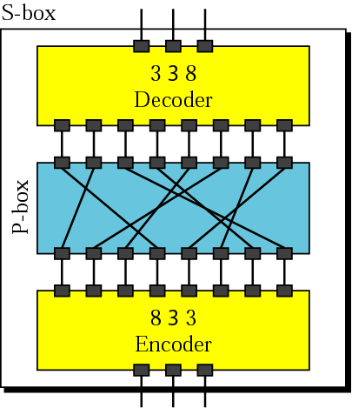
Figure 29.10 S-box

Slide 22
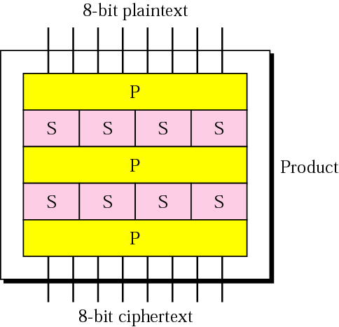
Figure 29.11 Product block

Slide 23
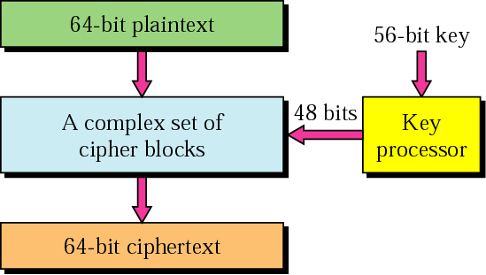
Figure 29.12 DES

Slide 24
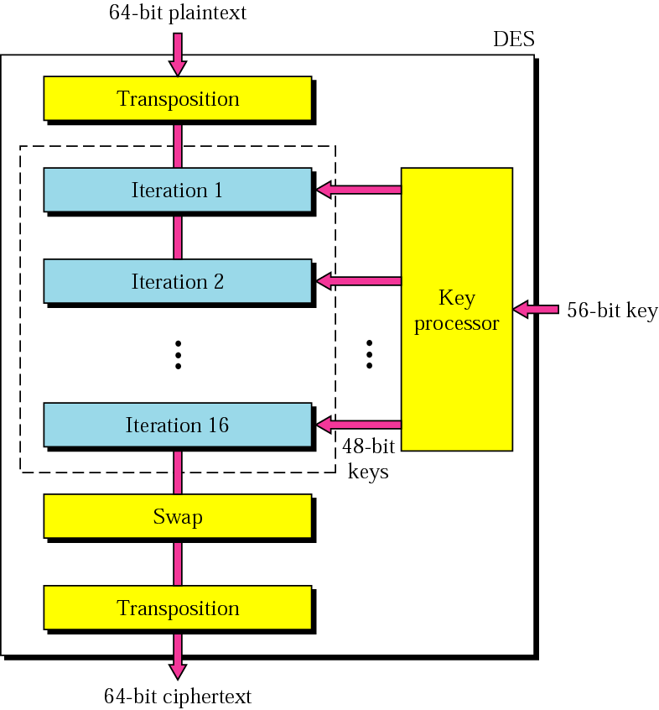
Figure 29.13 General scheme of DES

Slide 25
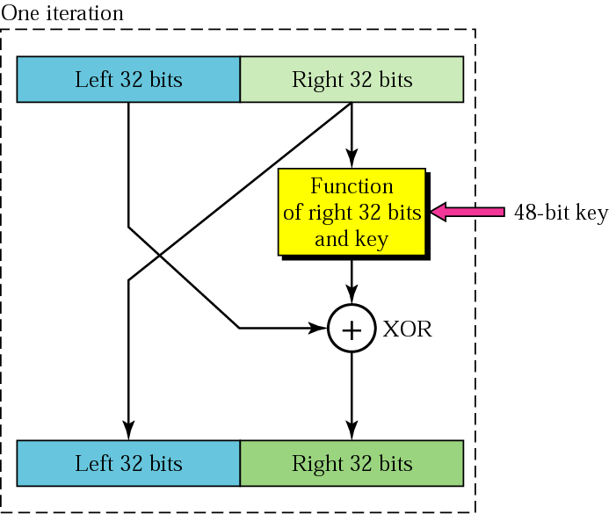
Figure 29.14 Iteration block

Slide 26
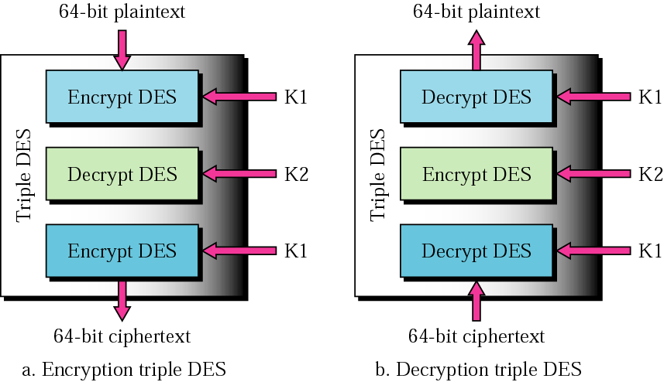
Figure 29.15 Triple DES

Slide 27
Note:
The DES cipher uses the same concept as the Caesar cipher, but the encryption/decryption algorithm is much more complex due to the sixteen 48-bit keys derived from a 56-bit key.

Slide 28
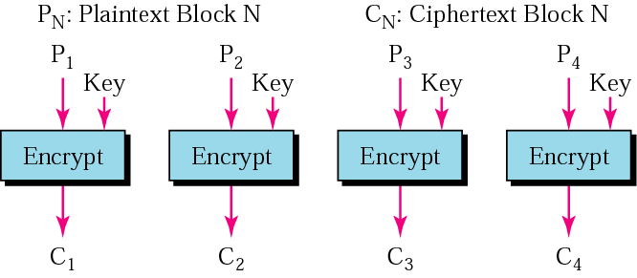
Figure 29.16 ECB mode

Slide 29
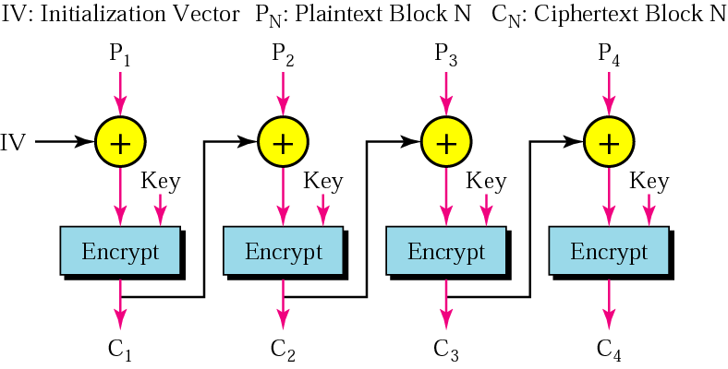
Figure 29.17 CBC mode

Slide 30
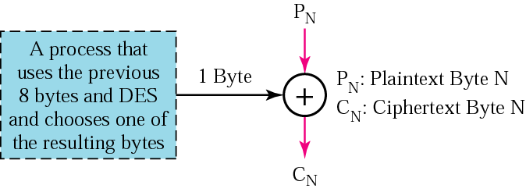
Figure 29.18 CFM

Slide 31
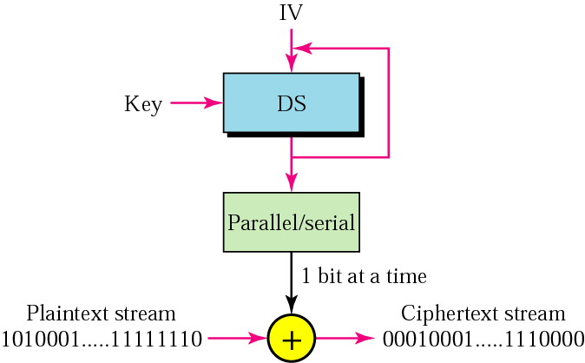
Figure 29.19 CSM

Slide 32
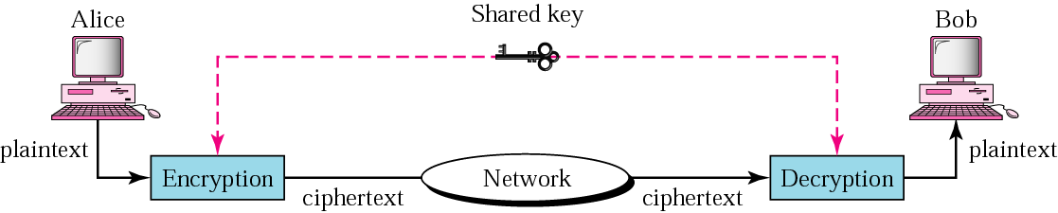
Figure 30.2 Privacy using symmetric-key encryption

Slide 33
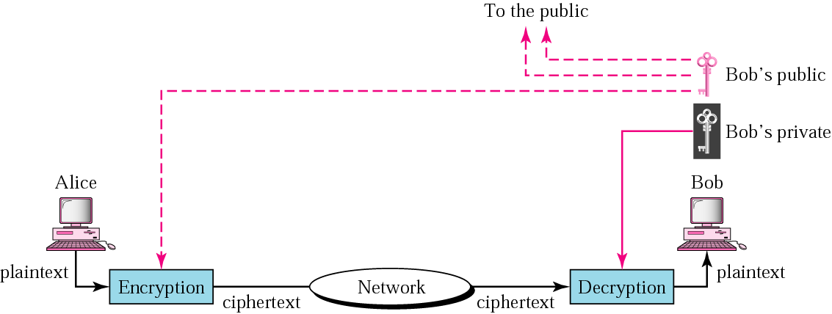
Figure 30.3 Privacy using public-key encryption

Slide 34
30.2 Digital Signature
Signing the Whole Document
Signing the Digest

Slide 35
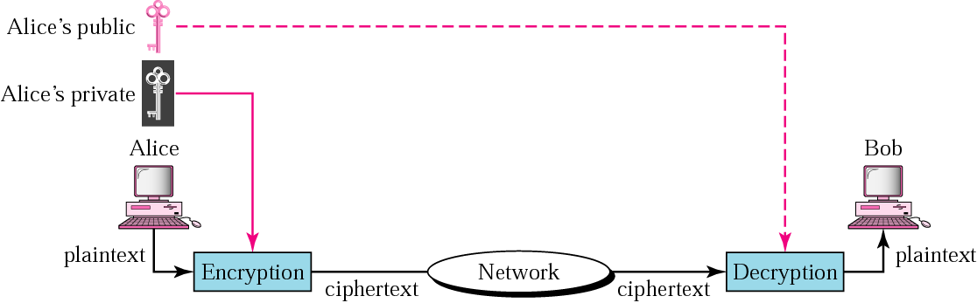
Figure 30.4 Signing the whole document

Slide 36
Note:
Digital signature does not provide privacy. If there is a need for privacy, another layer of encryption/decryption must be applied.

Slide 37
29.3 Public-Key Cryptography
RSA
Choosing Public and Private Keys

Slide 38

Figure 29.20 Public-key cryptography

Slide 39
Note:
Public-key algorithms are more efficient for short messages.

Slide 40
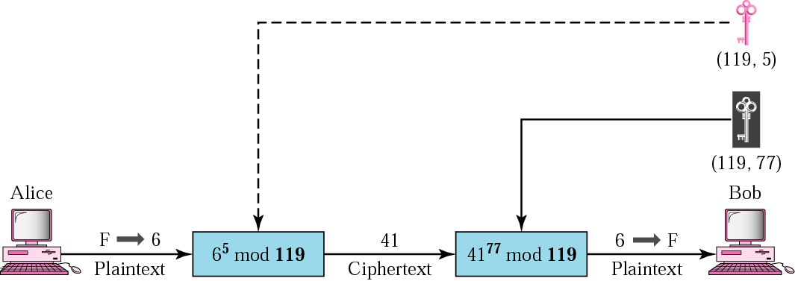
Figure 29.21 RSA

Slide 41
31.4 Firewalls
Packet-Filter Firewalls
Proxy Firewalls

Slide 42
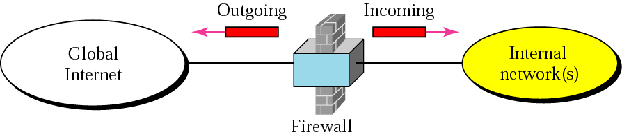
Figure 31.9 Firewall

Slide 43
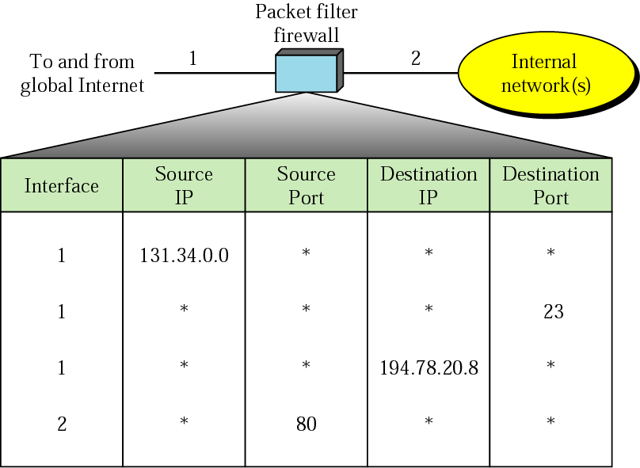
Figure 31.10 Packet-filter firewall

Slide 44
Note:
A packet-filter firewall filters at the network or transport layer.

Slide 45
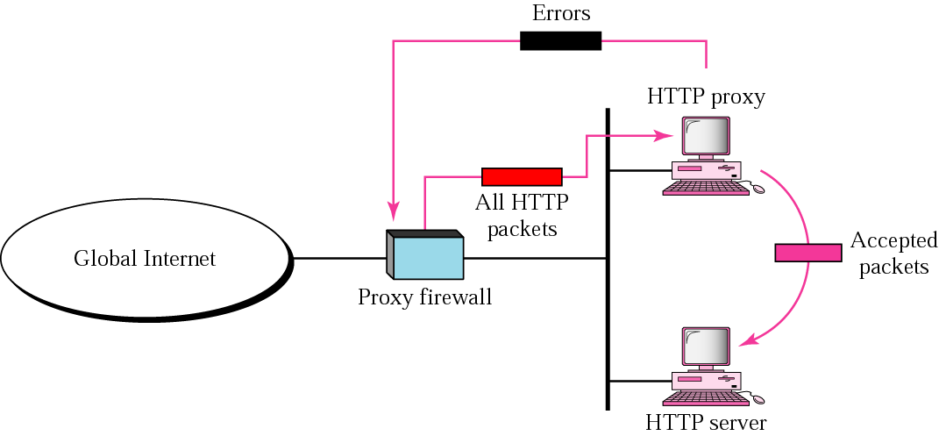
Figure 31.11 Proxy firewall

Slide 46
Note:
A proxy firewall filters at the application layer.

